Slide 1


“Online Job Portal”
Submitted by: Asmita Rokade
Submission type : Individual
Name:Asmita Jotiram Rokade
Batch : WOB B1
LMS Id :MGSA_409
Program : Axis Java
Date: 18/05/2000

Slide 2

Table of contents
Introduction
Project Overview
Architecture Design
User Interface Design
Back-end Development
Front-end Development
Testing
Deployment
Conclusion
Future Work
References
Appendices

Slide 3

Introduction
This project is aimed at developing an online search Portal for the Placement Details for job seekers.
The system is an online application that can be accessed throughout the organization and outside as well with proper login provided.
This system can be used as an Online Job Portal for job seekers.
Job Seekers logging should be able to upload their information in the form of a CV.
Visitors/Company representatives logging in may also access/search any information put up by Job aspirants.

Slide 4
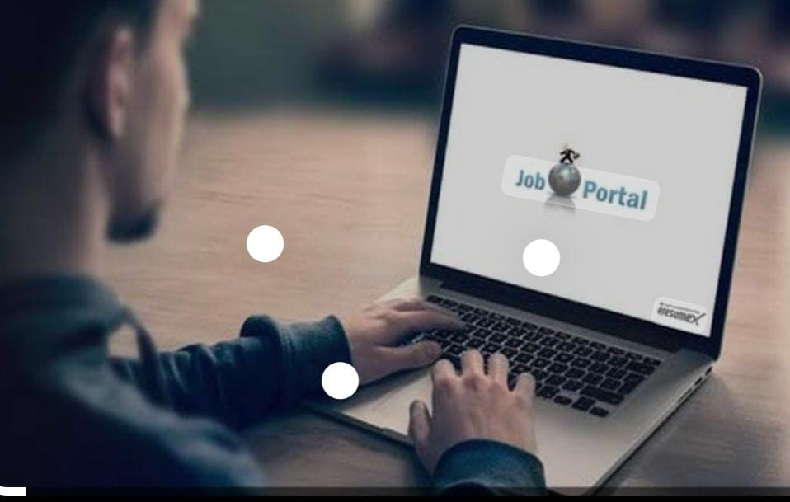
Project Overview
The world of job hunting can be overwhelming, but with the help of online job portals, the process has become much simpler.
These platforms are designed to help job seekers find relevant positions and apply for them with ease.
One of the most crucial features of an online job portal is the ability for job seekers to upload their CV or resume.
This makes it easy for potential employers to get a glimpse of their qualifications

Slide 5
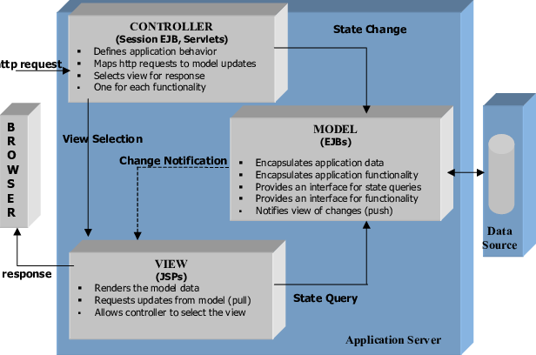
Architecture Design

Slide 6
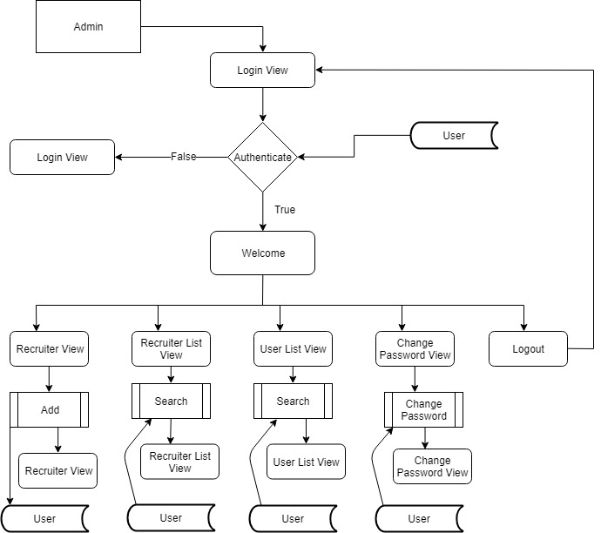
User Interface Design
Admin
View

Slide 7
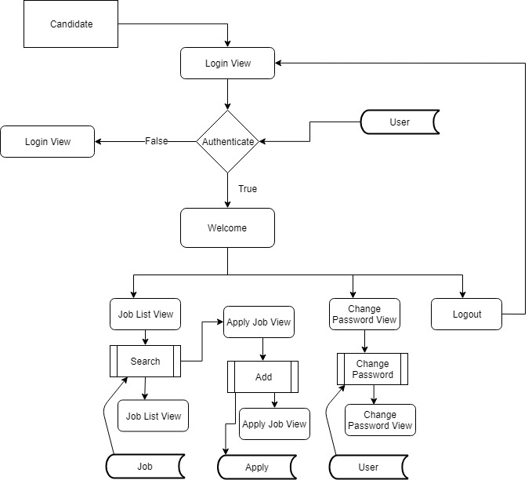
User Interface Design
Candidate View

Slide 8
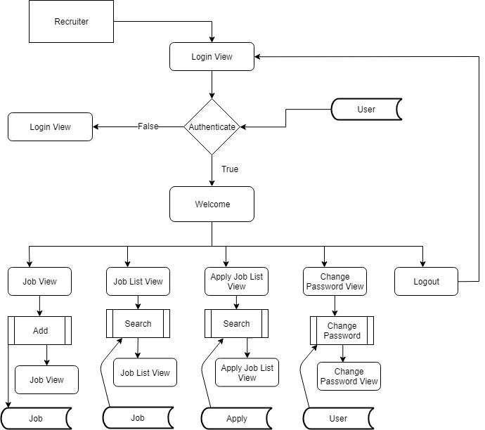
User Interface Design
Recruiter View

Slide 9
Back-end Development
Spring Boot helps developers create applications that just run. Specifically, it lets you create standalone applications that run on their own, without relying on an external web server, by embedding a web server such as Tomcat into your app during the initialization process.
Spring Boot:
Hibernate reduces lines of code by maintaining object-table mapping itself and returns result to application in form of Java objects. It relieves programmer from manual handling of persistent data, hence reducing the development time and maintenance cost.
Hibernate
Hibernate is an implementation of JPA and uses common standards of Java Persistence API. It is the standard API that allows developers to perform database operations smoothly. It is used to map Java data types with database tables and SQL data types.
JPA

Slide 10
Front-end Development
HTML:
“Hypertext Markup Language” is the language used to tell your web browser what each part of a website is. So, using HTML, you can define headers, paragraphs, links, images, and more, so your browser knows how to structure the web page you're looking at.
CSS:
(Cascading Style Sheets) is used to style and layout web pages — for example, to alter the font, color, size, and spacing of your content, split it into multiple columns, or add animations and other decorative features.
BOOTSTRAP:
What is Bootstrap used for? Bootstrap makes responsive web design a reality. It makes it possible for a web page or app to detect the visitor's screen size and orientation and automatically adapt the display accordingly.
JSP:
JSP supports both scripting and element-based dynamic content, and allows programmers to develop custom tag libraries to satisfy application-specific needs. JSP pages are precompiled for efficient server processing.

Slide 11
Integration and Testing
Unit testing:
Unit testing tests the functionality of individual units of source code. It is the smallest component of a testable software that works in isolation with other parts of the code. I have done unit testing for various individual components of the source code to uncover errors within the boundary of the application.
Integration testing:
Integration testing focuses on the design and construction of the software. Here the individual components that are tested using unit tests are combined and tested as a group. Its primary purpose is to expose the defects associated with the interfacing of modules. It checks if the modules perform the desired functionality when integrated together.

Slide 12
Conclusion
It has been a great pleasure for me to work on this exciting and challenging project. This project proved good for me as it provided practical knowledge of not only programming in JAVA and Spring Boot web based application and no some extent Windows Application and SQL Server, but also about all handling procedure related with “Online Job Portal”. It also provides knowledge about the latest technology used in developing web enabled application and client server technology that will be great demand in future. This will provide better opportunities and guidance in future in developing projects independently.

Slide 13

Future Work
Resume builder for jobseekers
Job seekers see the job as per his/her interest according to requirements
To give suggestions to make presentable job profile
Job posting : simple and premium
SMS alerts or premium job service for jobseekers
Ads on website

Slide 14
References
https://www.tutorialspoint.com/java/
http://www.javapoint.com/java-tutorial
http://docs.oracle.com/javase/tutorial/
https://o7planning.org/11705/create-application-with-spring-boot-spring-security-jpa
https://www.devglan.com/spring-boot/spring-boot-jpa-hibernate

